Slide 1
Vision Based Road Sign Detection and Recognition using Support Vector Machine

Slide 2
Abstract
This work proposes a novel system for the automatic detection and recognition of traffic signs.
A new method for the detection of road signs is proposed based on HSV color space detection, in order to locate Regions of Interest (ROI).
The canny edge detection is applied from the extracted road image and HOG feature is extracted.
The extracted feature is fed to the Support Vector Machine Classifier for recogniting the road signs.

Slide 3
Modules
Road Sign Detection
Feature Extraction
Road Sign Recognition

Slide 4
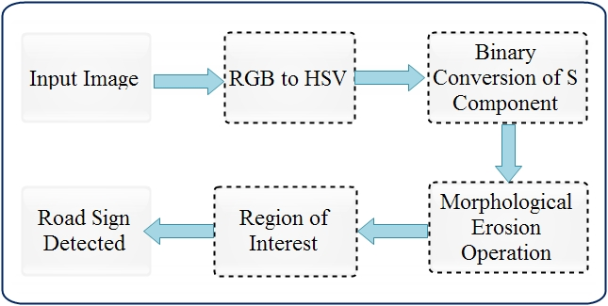
Road Sign Detection

Slide 5
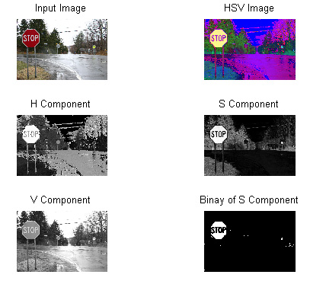
Road Sign Segmentation using HSV Color

Slide 6
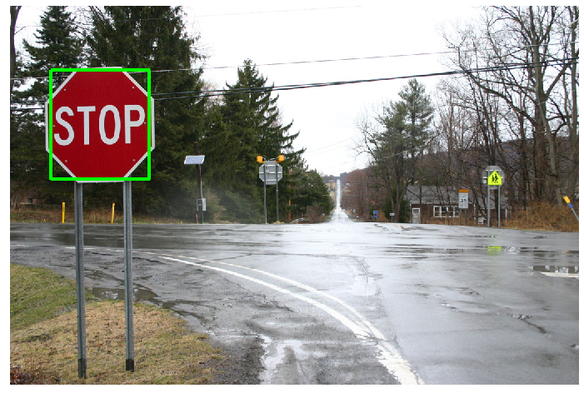
Road Sign Detection using ROI

Slide 7
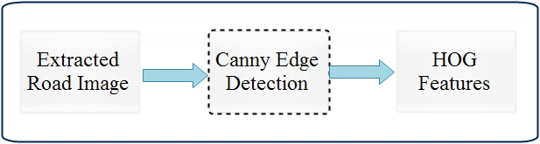
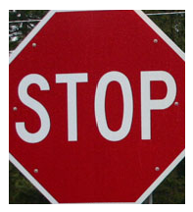

Feature Extraction
HOG Feature
Extraction

Slide 8
HOG Feature Extraction
3 X 3 win size
5 bin size

